Slide 1
Insertions

Slide 2
Insertions are a type of translocation
insertional translocation
interstitial translocation
non-reciprocal translocation
Interchromosomal insertion
one-way or reciprocal
Intrachromosomal insertion (very rare, only 70 cases published)
Direct insertion (dir ins) or inverted insertion (inv ins)
Insertions were classified rare (1 in 80,000, classic cytogenetics detection), now classified uncommon (sixfold more, microarray detection)

Slide 3
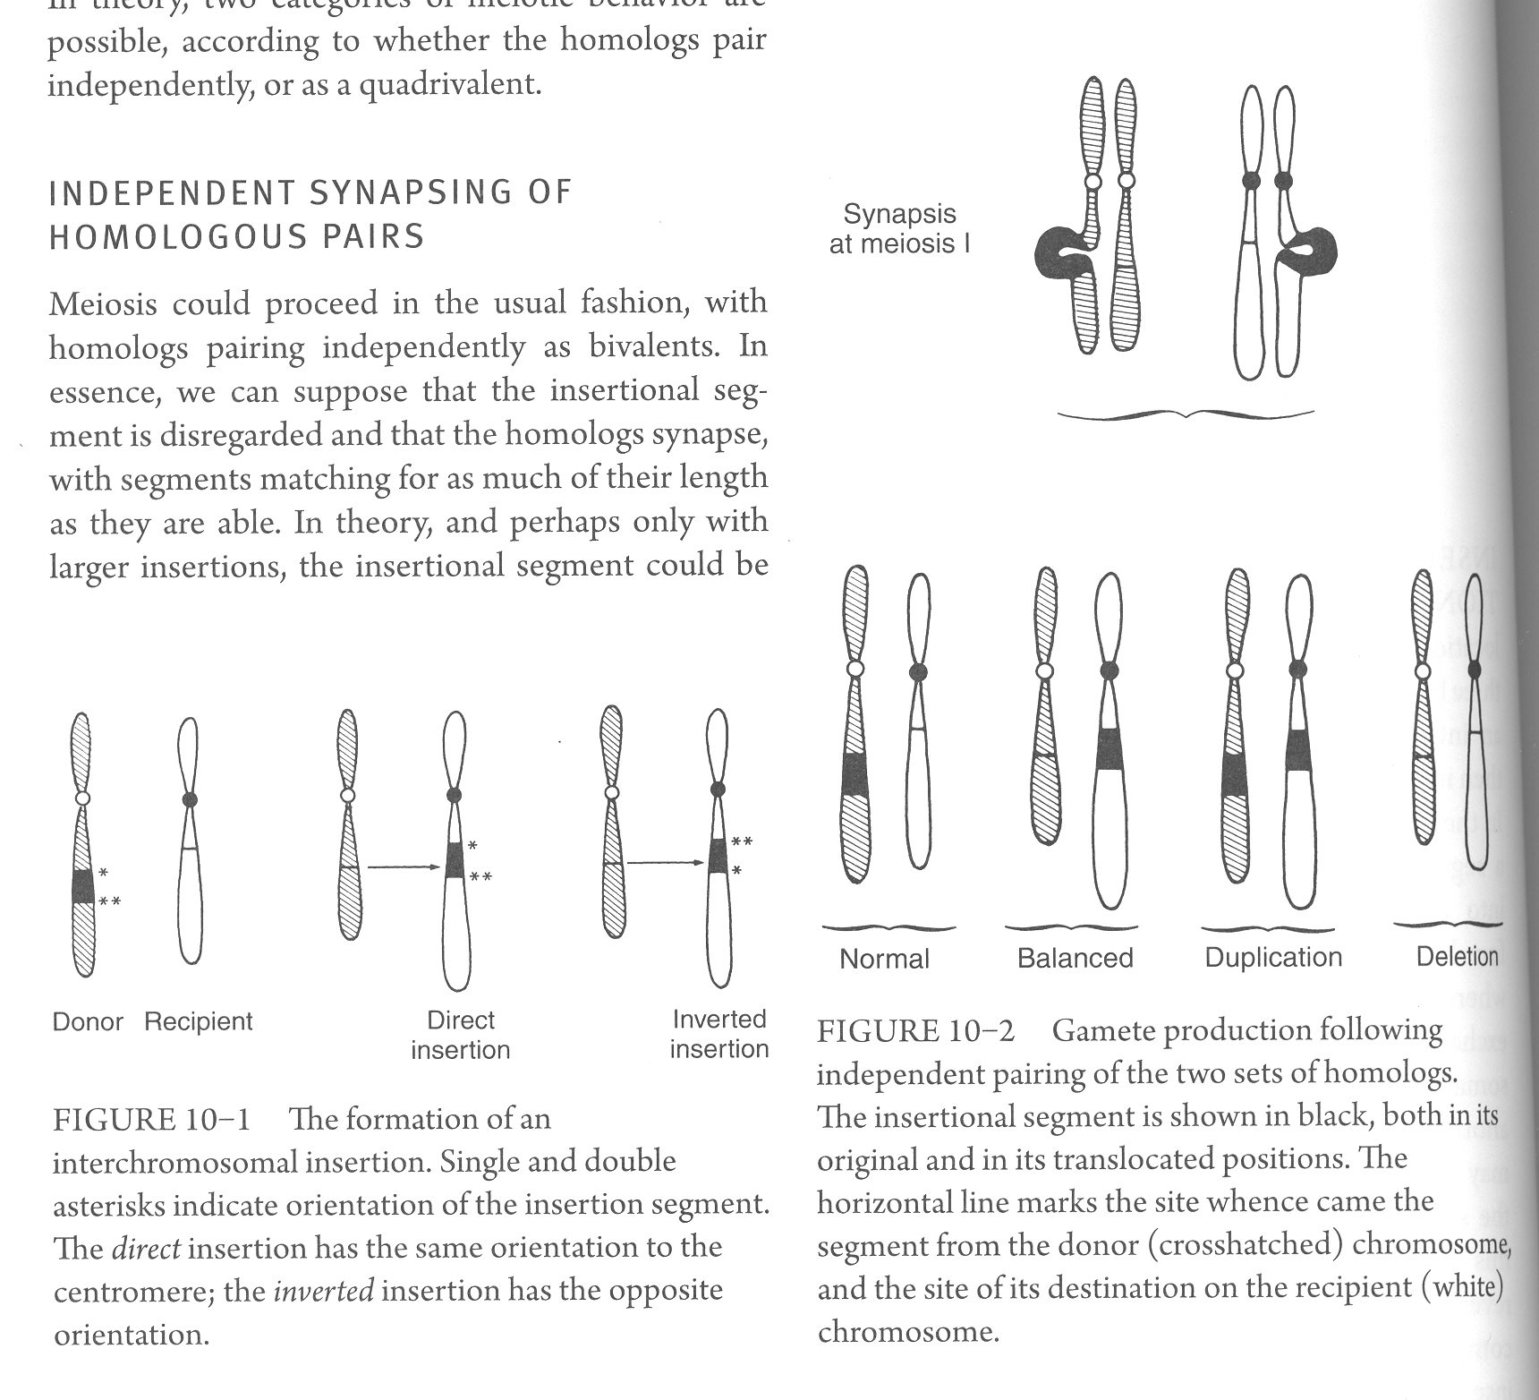
The simple one-way inter-chromosomal insertion is the most common form

Slide 4
Independent synapsing of homologous pairs
Bivalents
Independent synapsing is more likely to apply when the insertional segment is of small size

Slide 5
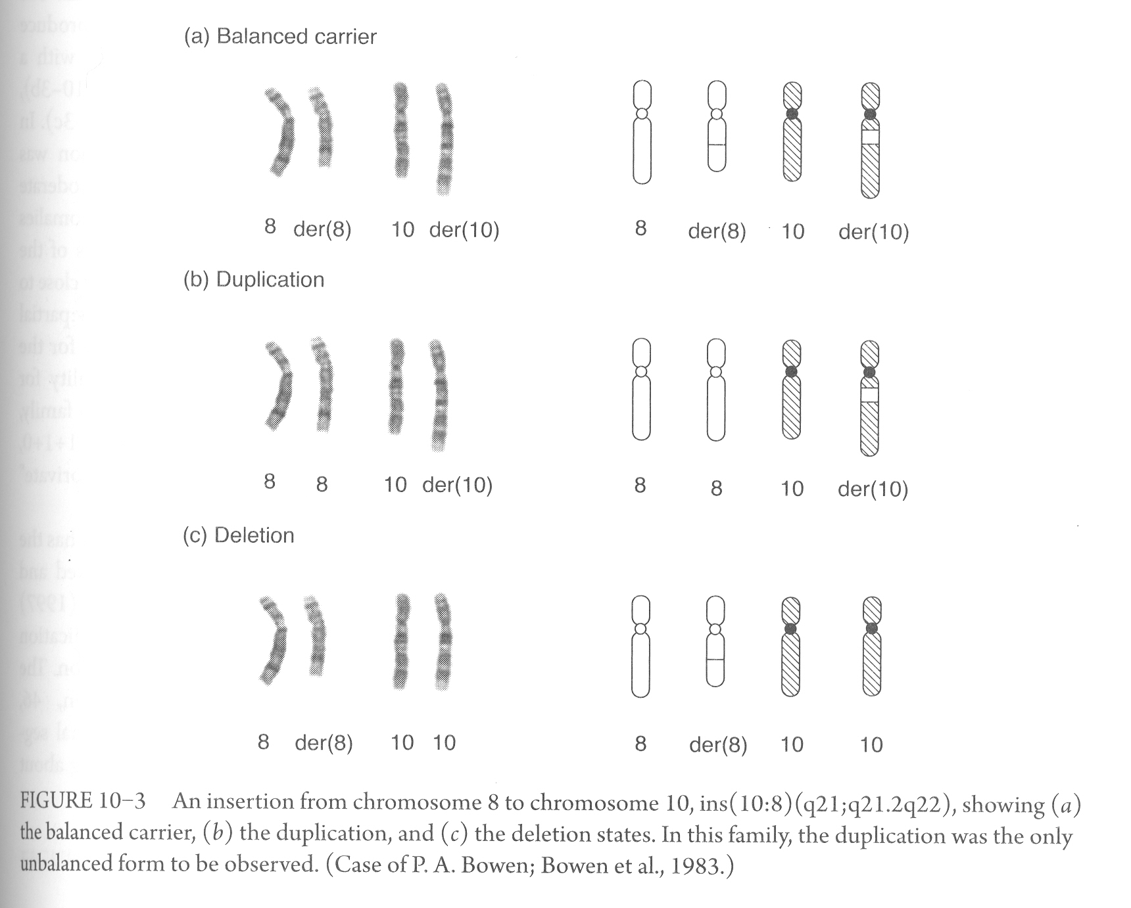

Slide 6
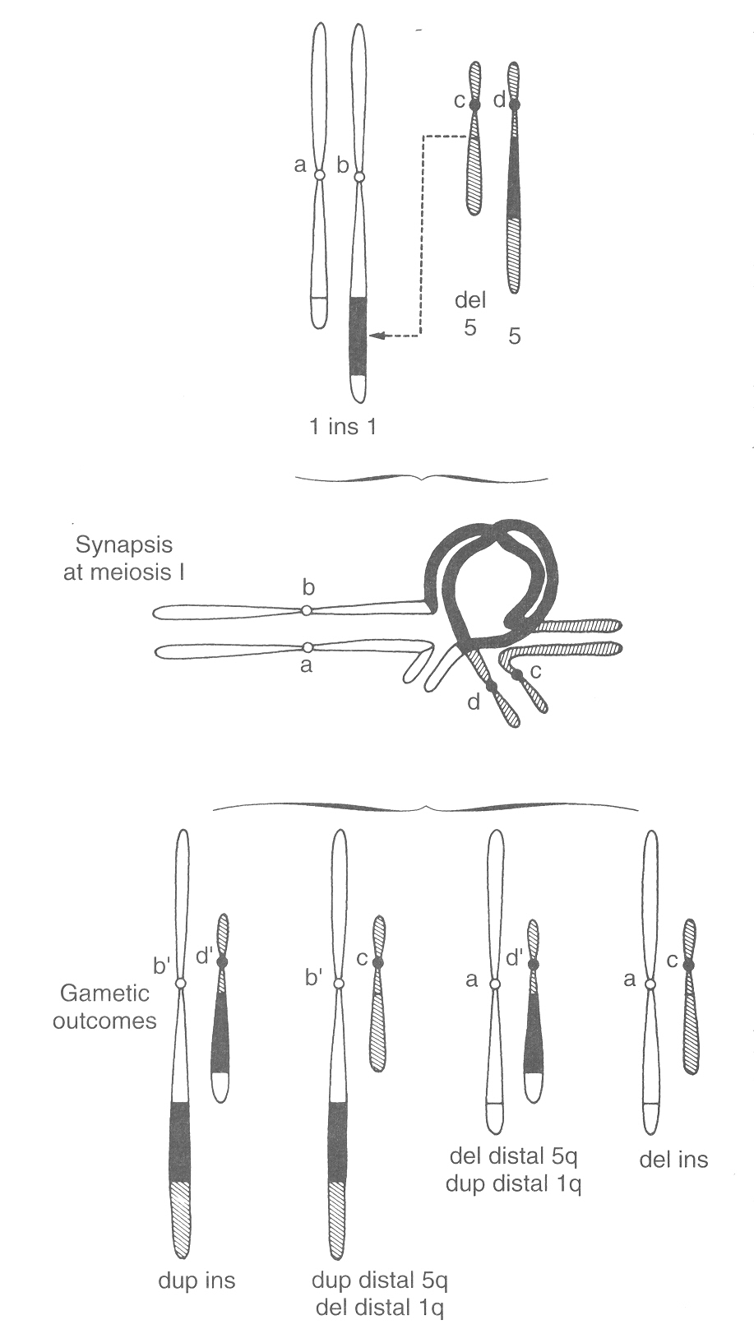

Formation of quadrivalent
Happen with larger insertional segments
If no crossover happen in the inserted sequence then the result would be the same as of bivalents (independent synapsing)
When crossover happen in the inserted segment, then 4 possibilities occur, the least imbalanced, least monosomic is the dup ins combination

Slide 7
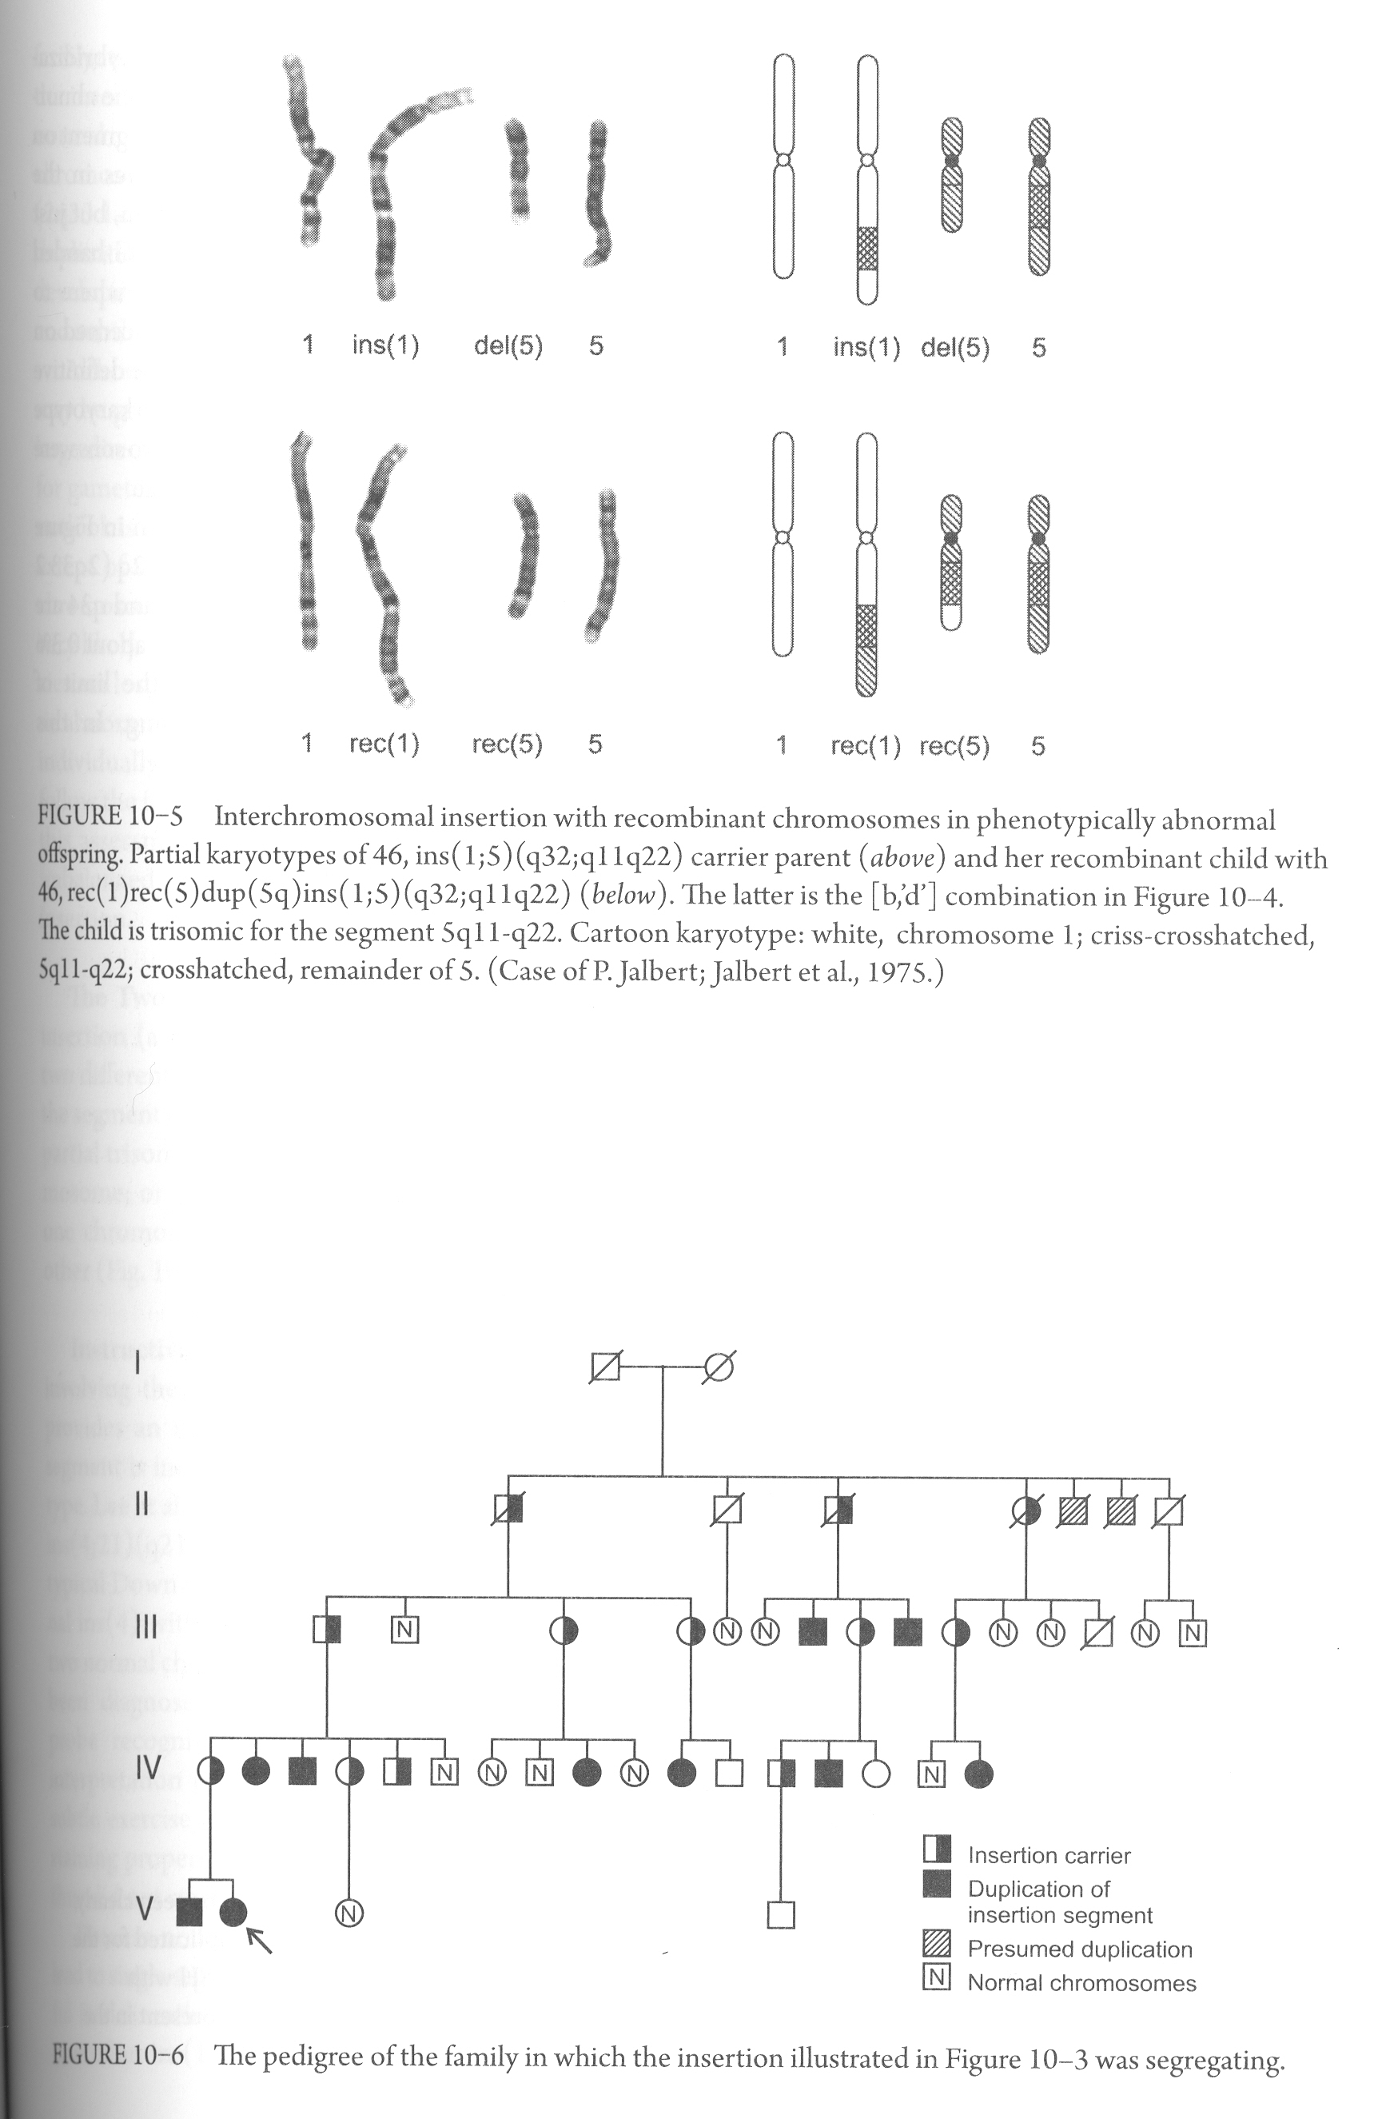

Slide 8
Segment content and viability
Segment of chromosome 8 is inserted into chromosome 10
In this family only duplication was observed (no deletions) with segregations ratio of 1:1:1:0 (normal:balanced:parial trisomy:partial monosomy)
Risk of having aneuploid child is 1/3 (private segregation analysis)
If insertion is smaller, then monosomics might be viable

Slide 9
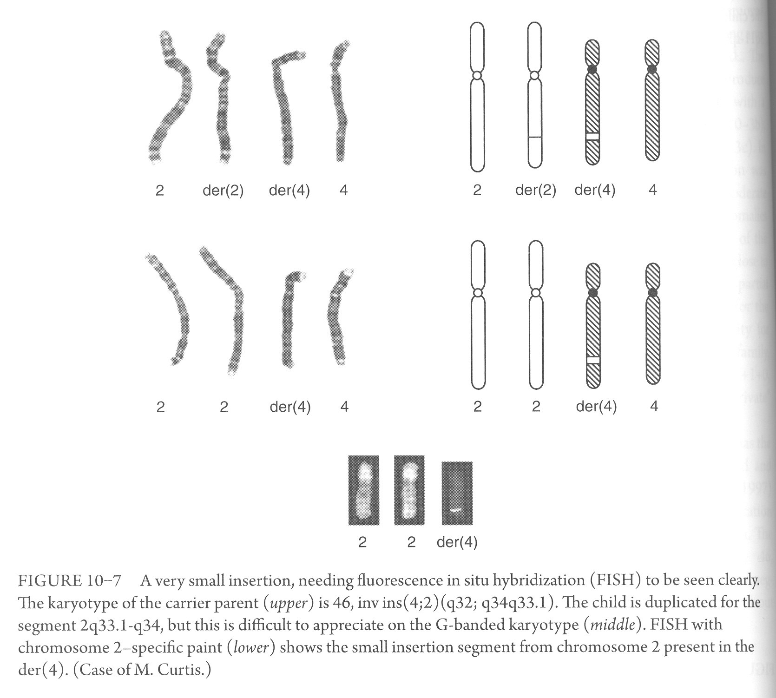
An insertion of a very small segment may, on classical cytogenetics, be difficult to detect, although with increasing use of microarray analysis, more such cases are coming to light

Slide 10
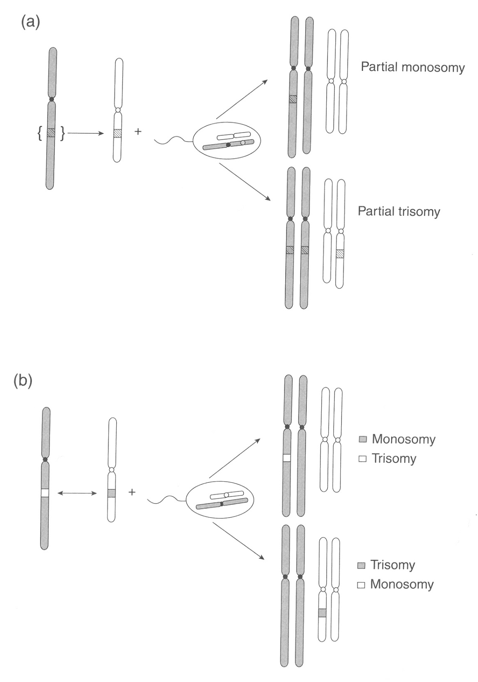
Two-way insertion
May result in partial monosomy of one chromosome with the reciprocal partial trisomy of the segment from the other chromosome
Figure. Insertional translocations and abnormal segregation.
One-way, single segment, or nonreciprocal insertion
Two-way, double-segment, or reciprocal insertion

